Slide 1
Inventory Management System
Ensuring throughout that you know what you have, where it is, and how to manage it.
Jibran Bilal Khan (20-SE-040)
Aliha Shehzad (20-SE-060)
Arslan Dilshad (20-SE-046)

Slide 2
Introduction
Inventory management system has become important factor in modern business field. This system should help the businessmen to streamline the administrative task and provide real-time access to the data, Building this system interface will further help the ease of accessibility through the provided portal. The study findings enable the definition of the project problem statement, its objectives, scopes and advantages of the inventory management system.

Slide 3
Purpose
The purpose of this document is to present a detailed description of the inventory management system, it will explain the purpose and features of the software, the interfaces of the software, what the software will do, the constraints under which it must operate and how the software will react to external stimuli, this document is intended for both the end users and the developers of the software
The inventory management system has to handle records for the number of products and maintenance was difficult. Though it has used an informing system, it was totally manual. Hence there is a need to upgrade the system with a computer-based information system

Slide 4
Scope
This document covers the requirements for the inventory management system. This software will provide a graphical environment in which the users of the system will be able to perform various operations that are associated with storing, marinating, updating and retrieving product information. The purpose of this is to guide developers in selecting a design that will be able to accommodate the full-scale application. This system will capture information about customer’s personal details products and their quantities. Storing, updating and retrieving in a fast and secure way.

Slide 5
Overview
The purpose of this document is to present a detailed description of the inventory management system, it will explain the purpose and features of the software, the interface of the software will react to external stimuli. This document is intended for both the end users and the developers of the software.

Slide 6
General Description
Software Perspective :
The product inventory management system, is an independent product and does not depend on any other product or system. The product will automate various tasks associated with handling product details and better organizing the stored information and optimum performance, thus helping the businesses to ensure smooth working of these processes.

Slide 7
Software Functions
Our system has two types of access modes;
Administrator
Customer
Administrator IMS is managed by Administrator, admin has to update and monitor the registered product details, add a new product, provide product numbers for all projects, assign each product details, add a new product, provide product number for all products, assign each product quantity and GST etc., Administrator can be update his profile and also can give help to the customers.
Customer can purchase the products and make payment accordingly. All this data will be saved into the database by the administrator to keep record of the sold products.

Slide 8
Assumptions and Dependencies
We assume that the office personnel do all the data entry based and the correct values obtained from forms and registers.
We assume that the computers that will use the software will be part of the having proper platform to run it.
Users with administrator access should be careful in deleting or modifying any information knowingly or unknowingly which will lead to inconsistency of the database.
The end users of this software are assumed to have basic level of computer knowledge i.e point and click.

Slide 9
Specific Requirements
External Interface Requirements
User interfaces
GUI along with meaningful frames and buttons
Reports are generated as per the requirement
Hardware Interfaces
Hardware Environment : Dual Core 2nd Gen or Above
System Configuration : Ram-4GB HDD-80GB
Operation System : Windows 7 (64-bit) or above
Software interfaces
Front end: JAVA
Back end: C++
When invalid inputs are given to the modules then the error messages will be popped up in order to inform the user that the input provided is not taken by the database. When incomplete information is provided by the user and the user tries to submit the form in order to store the details in the database. The system will pop up a message box asking the user to enter all the details required

Slide 10
Deliverables
Software Project Management Plan (SPMP)
Project on Inventory Control System (PICS)
Software Requirements Specifications (SRS)
Software Architecture Design Document (SADD)
Work Breakdown Structure
Milestone Report
Software Design Document (SDD)
Risk Management Plan
Quality Assurance Plan
Source and Object Code
User Manual

Slide 11
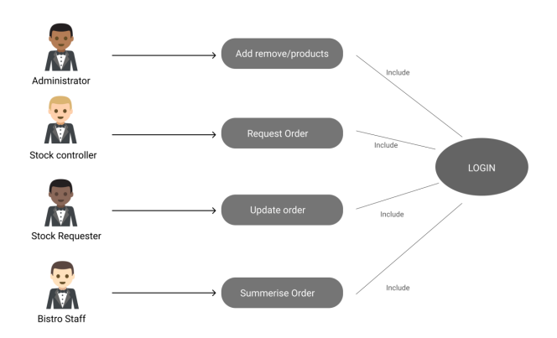
USE CASE DIAGRAM:

Slide 12
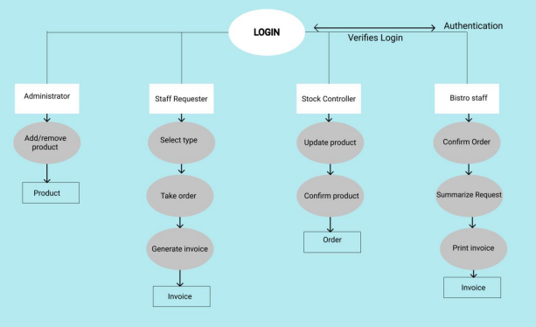
Activity diagram

Slide 13
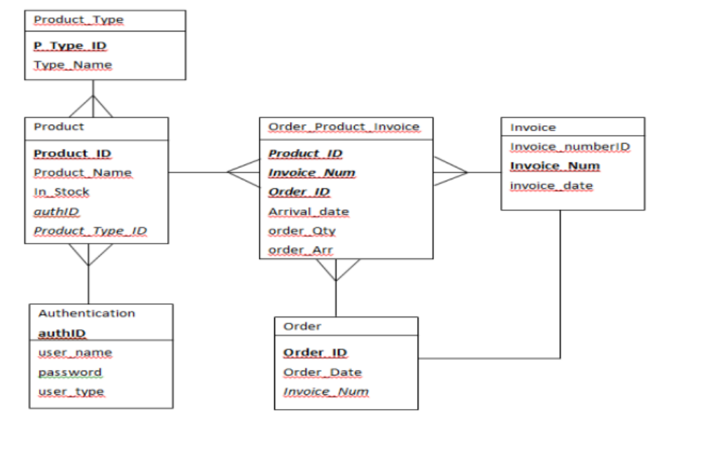
Class Diagram

Slide 14
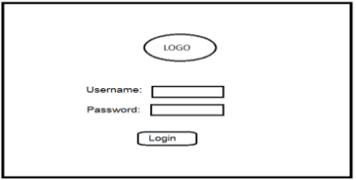
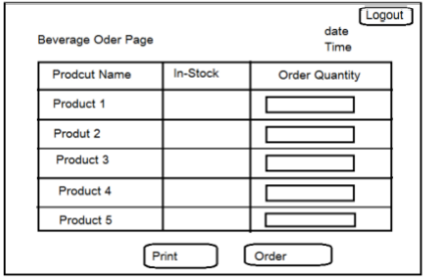
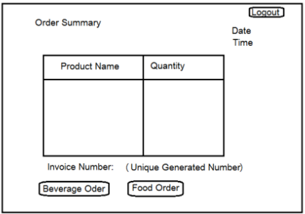
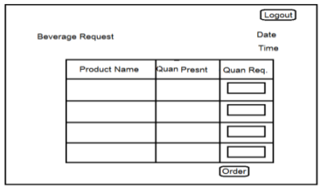
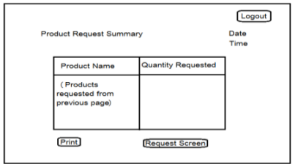
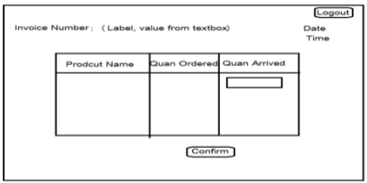

Slide 15
Functional Requirements
Customer Registration:
IMS provides customer registration and status information to the administrator to view their status
IMS provides automatic customer register number generation based on randomization algorithm
IMS provides to customer to purchase products and enlist them in their profiles
Product Management
Easily track product information (sold and available)
Quickly produce reports for single or multiple sold products.

Slide 16
Authentication
The new system will provide the functionality that allows the client and manager of rundle bistro bar to login to the new system with their unique username and password. Then they will be guided to the next page based on their username. (Essential)
Validation
If the client will enter the wrong username or password, then they cannot access or login to the new system. (Essential)
Browse stock details
The new system will allows the client to browse all the available stock details after successful login in to the system. (Essential)
Update stock
This function allows manager and stake holder update the details of the stock. (Essential)
Enter new item in inventory
This function allows user to enter or add the new item in the inventory. (Essential)

Slide 17
Remove item
This function allows user to remove or delete the item from the stock. (Essential)
Place an order
This function allows user to place an order for the required stock to the respective supplier. (Essential)
Generate invoice
The new system will also have the functionality to generate the invoice to check the ordered stock. (Essential)

Slide 18
Non-Functional Requirements
Performance
Easy tracking of record and updating can be done. All the requirements relating to performance characteristics of the system are specified in the section below. There are two types of requirements
Static requirements
These requirements do not impose any constraints on the execution characteristics of the system. They are:
Number of terminals: The software makes user of an underlying database that will reside at the same system, while the front end will be available to the administrative computer.
Number of users: The number of users can be administrator only but this software can be extended to applications for almost all staff members of the organization

Slide 19
Dynamic Requirements
These specify constraints on the execution characteristics of the system. They typically include response time and throughout of the system. Since these factors are not applicable to the proposed software, it will suffice if the response time is high and the transactions are carried out precisely and quickly.

Slide 20
Usability: The new system will be simple and easy for the use to client. (Essential)
Security: The new system will be secure from the unauthorized access. (Essential)
Privacy: The new system will also provide the safety to the user details and stock details. (Essential)
User-Friendly: The new system will provide more interaction to the user so that user can easily interact with the new system. (Essential)
Extensibility: The new system will have extensibility in future for the implementation of the new stock or items. (Negotiable)
Reliability: The software will not be able to connect to the database in the event of the server being down due to a hardware or software failure
Availability: The software will be available only to administrator of the organization and the product as well as customer details will be recorded by him. He can add customers, update, and delete them as well as add new products and manage them.
Security: The security requirements deal with the primary security. The software should be handled only by the administrator and authorized users. Only the administrator has right to create new accounts and generating inventory. Only authorized users can access the system with username and password of administrator
Maintainability: Backups for database are available.

Slide 21
Design Constraints:
This software provides security. The login form prevents the system from being misused by unauthorized users. Only an authorized operator will be granted rights to modify as per requirements. This software is also reliable and fault tolerant. The system developed is designed to handle invalid inputs. Since reliability is a major are of concern the system has a backup to avoid data loss. The user should know the programming language very well that is used to develop the software.
Database:
All data will be stored in relational database

Slide 22
That’s All Thank You

